Slide 1
An open source web application for real-time display of pending orders
Noah Hoffman, MD, PhD
University of Washington
Pathology Informatics Summit 2017

Slide 2
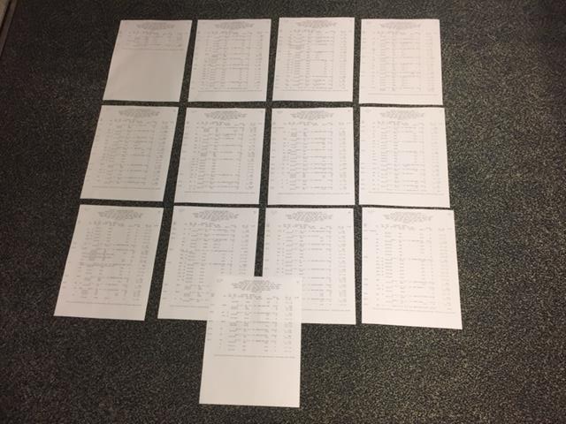
One printed report of pending orders
Notes:
Each area of the lab gathers information of the work that needs to be performed from various sources – orders are downloaded to instruments or lists of manual tests might be printed out in worksheets.
One of the main functions of the lab system is to receive orders for lab tests, organize them by instrument, method, or lab area, and then communicate these orders either to automated instruments, or to lab staff so that the testing can be performed.
Most lab systems provide a printed “pending list” that provides an overview of tests that have been waiting to be performed in a given area. The practice for how pending lists are used varies a lot between lab areas, but at least in our lab system, the ability to customize the report is limited. In a complex lab area with a high volume, this list can be very long, and it takes effort to find the actionable items.
I imagine that you have all seen printouts of pending tests like this one. Here’s a pending list for the group of worksheets used for our automated chemistry area.

Slide 3
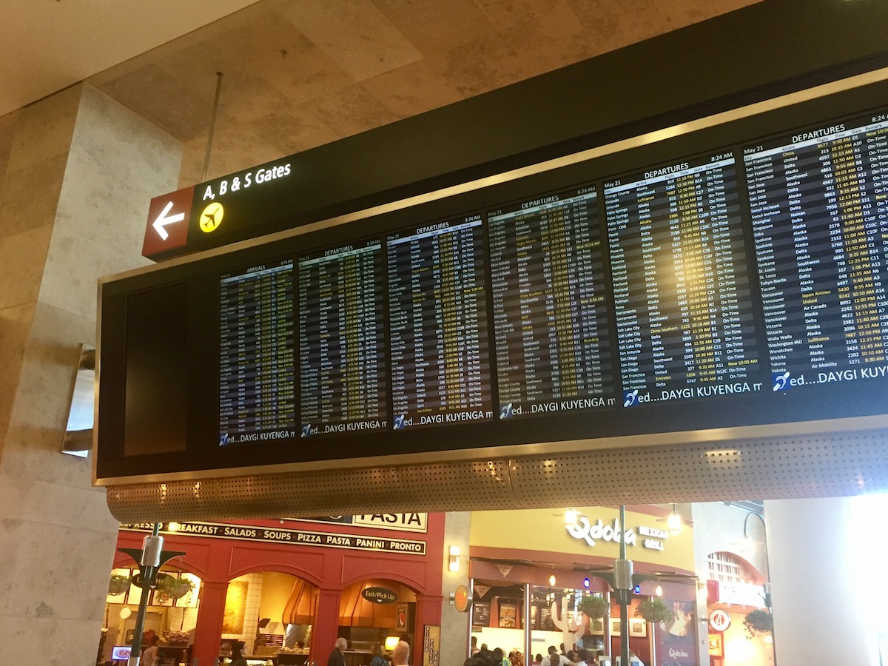
Notes:
The idea of listing pending orders on a screen in real time is of course both obvious and nothing new. Some lab systems provide this feature, with varying degrees of flexibility. Ours doesn’t. Commercial options for real time displays of pending orders or events do exist, but at the time we made our evaluation of various products, none met our criteria for data security, cost, or flexibility.

Slide 4
Real-time display of pending orders: operational objectives
Improve situational awareness in the lab
Replace batched “pull” with real-time “push”
Improve visibility of actionable pending orders
Reduce reliance on printed pending lists
Improve communication related to pending orders
Notes:
Given the relative simplicity of the requirements, and the availability of the necessary skills and infrastructure in our department, we decided that it would be worth implementing our own solution.

Slide 5
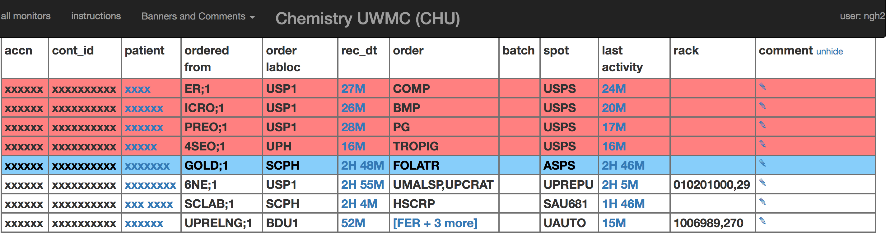
Less is More
Rows highlighted and sorted to top based on location and priority
Humanized time intervals
Orders grouped by patient and accession
Notes:
Here’s an example of the display, illustrating a few of the features. This one is also for the chemistry automation line.

Slide 6
Improving signal:noise
Filtering and sorting
Priority, time elapsed, test/order (eg, specimen stability), ordering location.
Grouping
patient, accession, container
Highlighting/formatting
Priority, time elapsed, ordering location
Notes:
The manipulation of the raw data from the lab system and provided to the application can be generalized into a few operations.

Slide 7
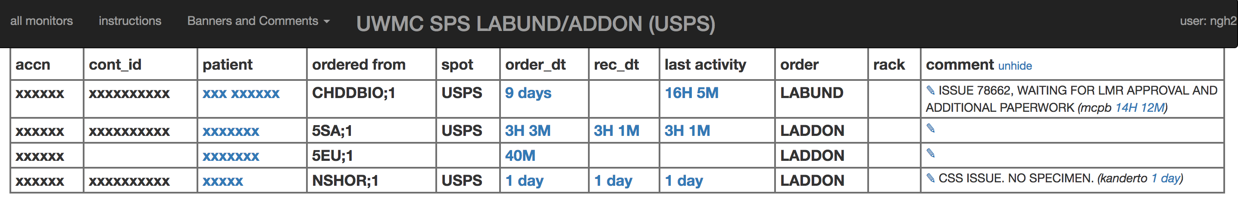
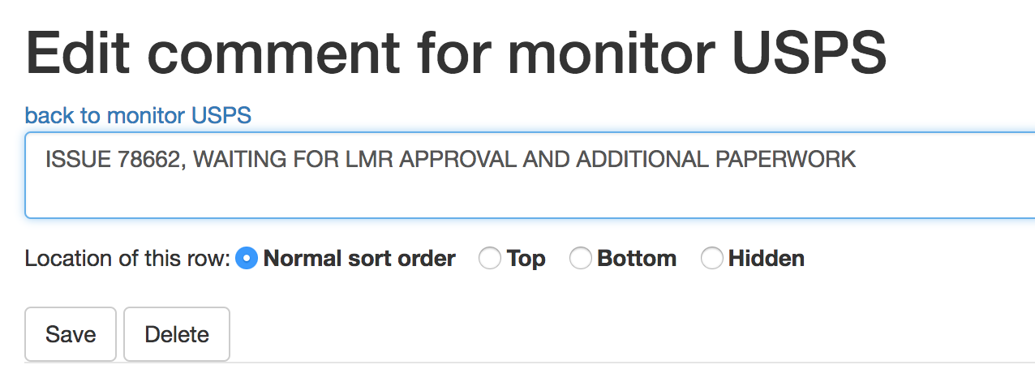
Communication via comments

Slide 8
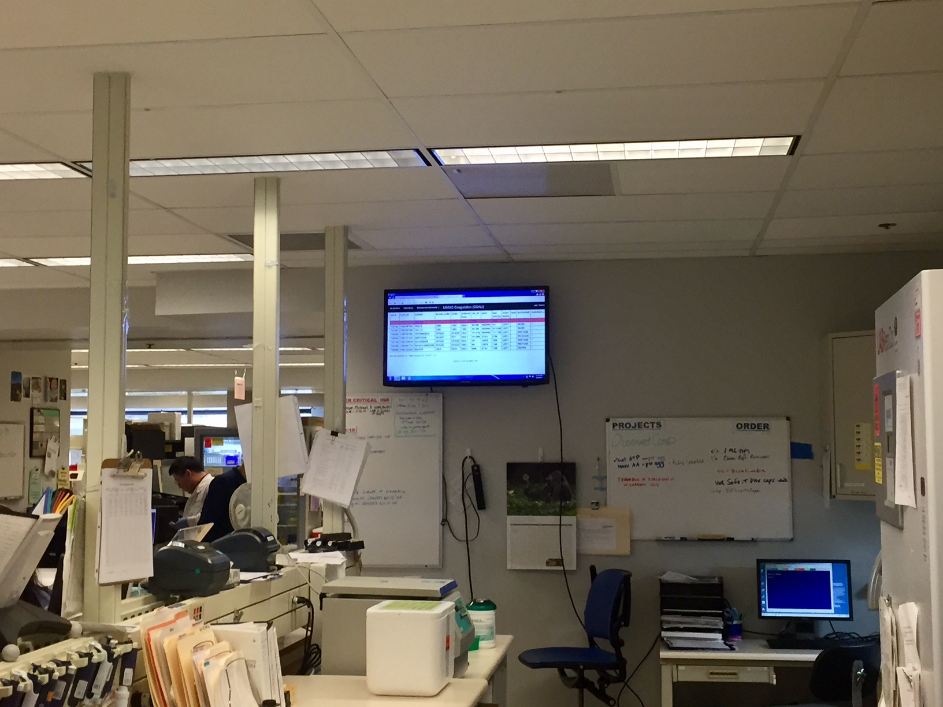
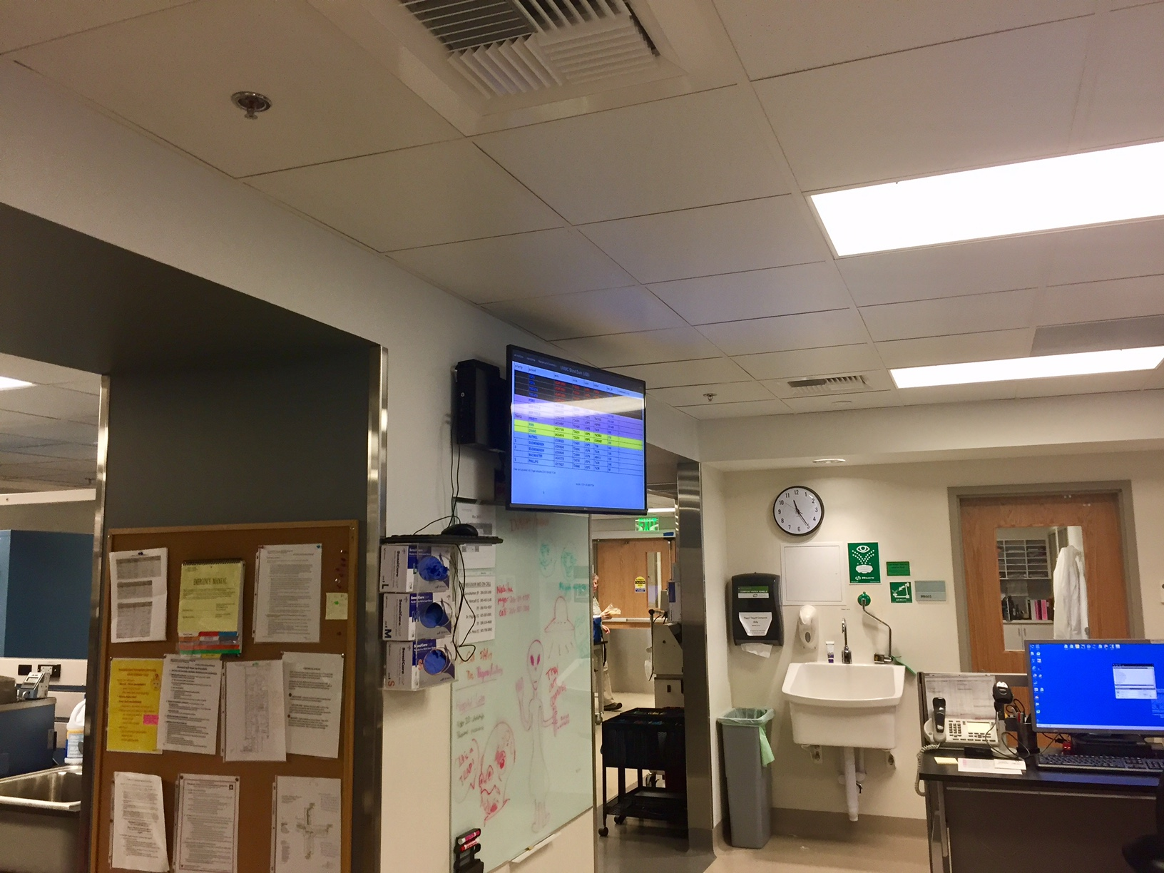
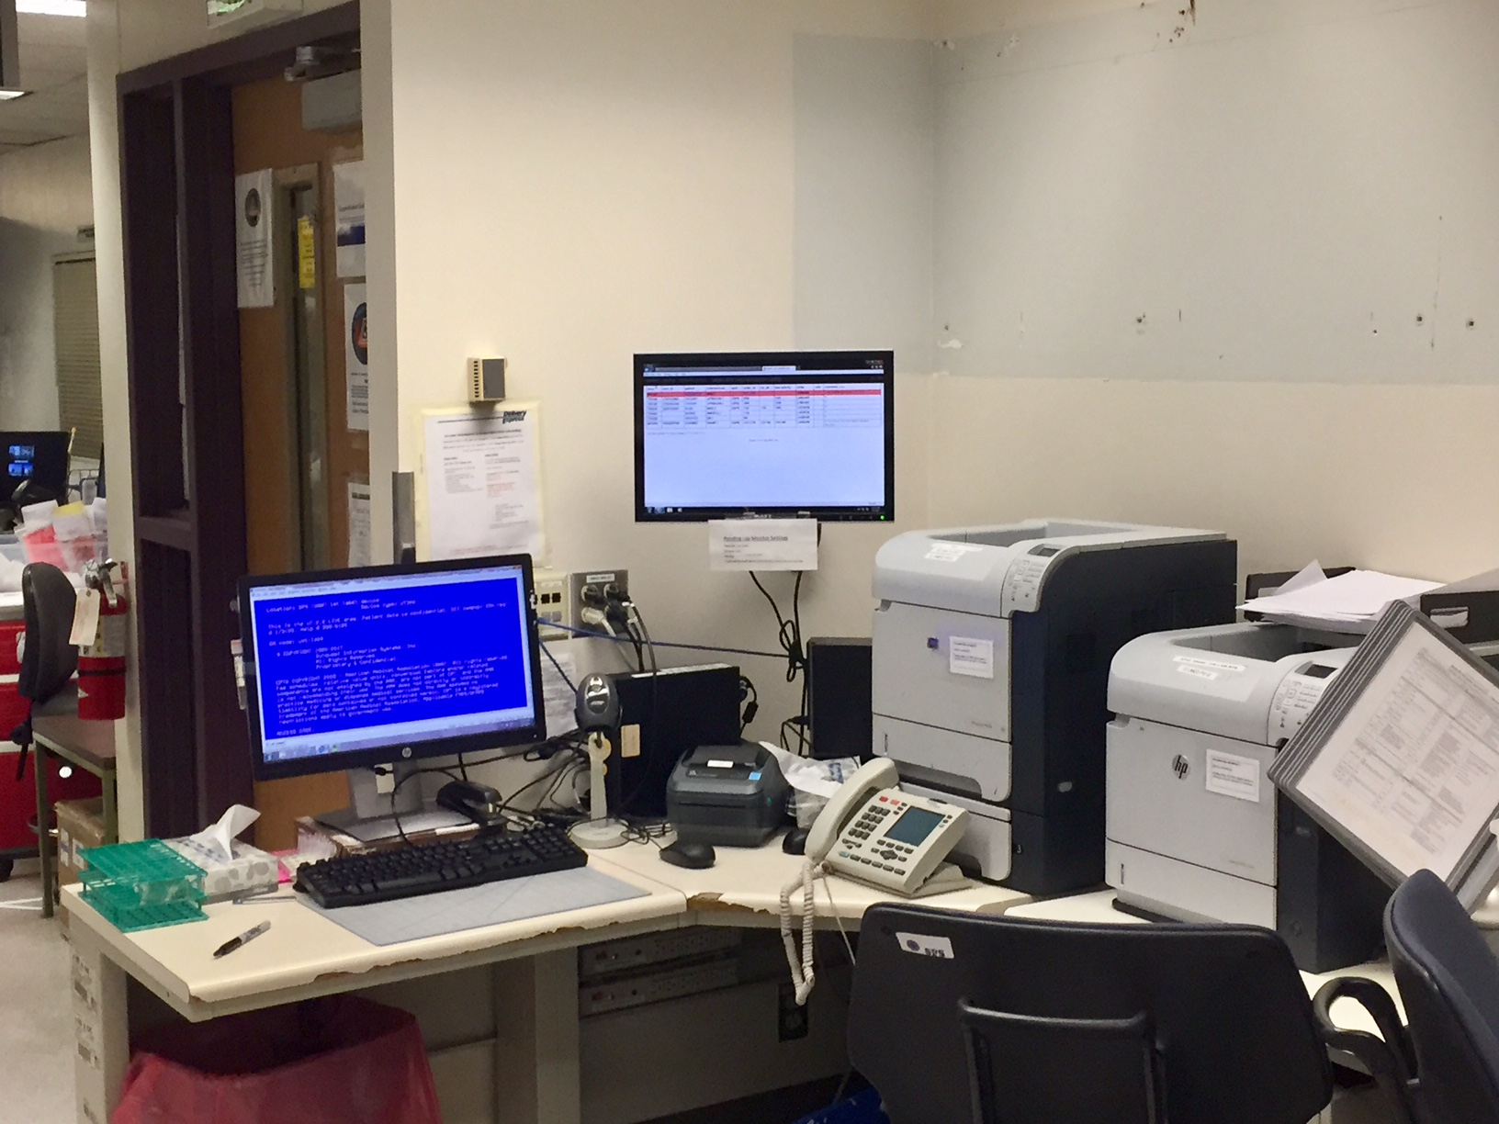
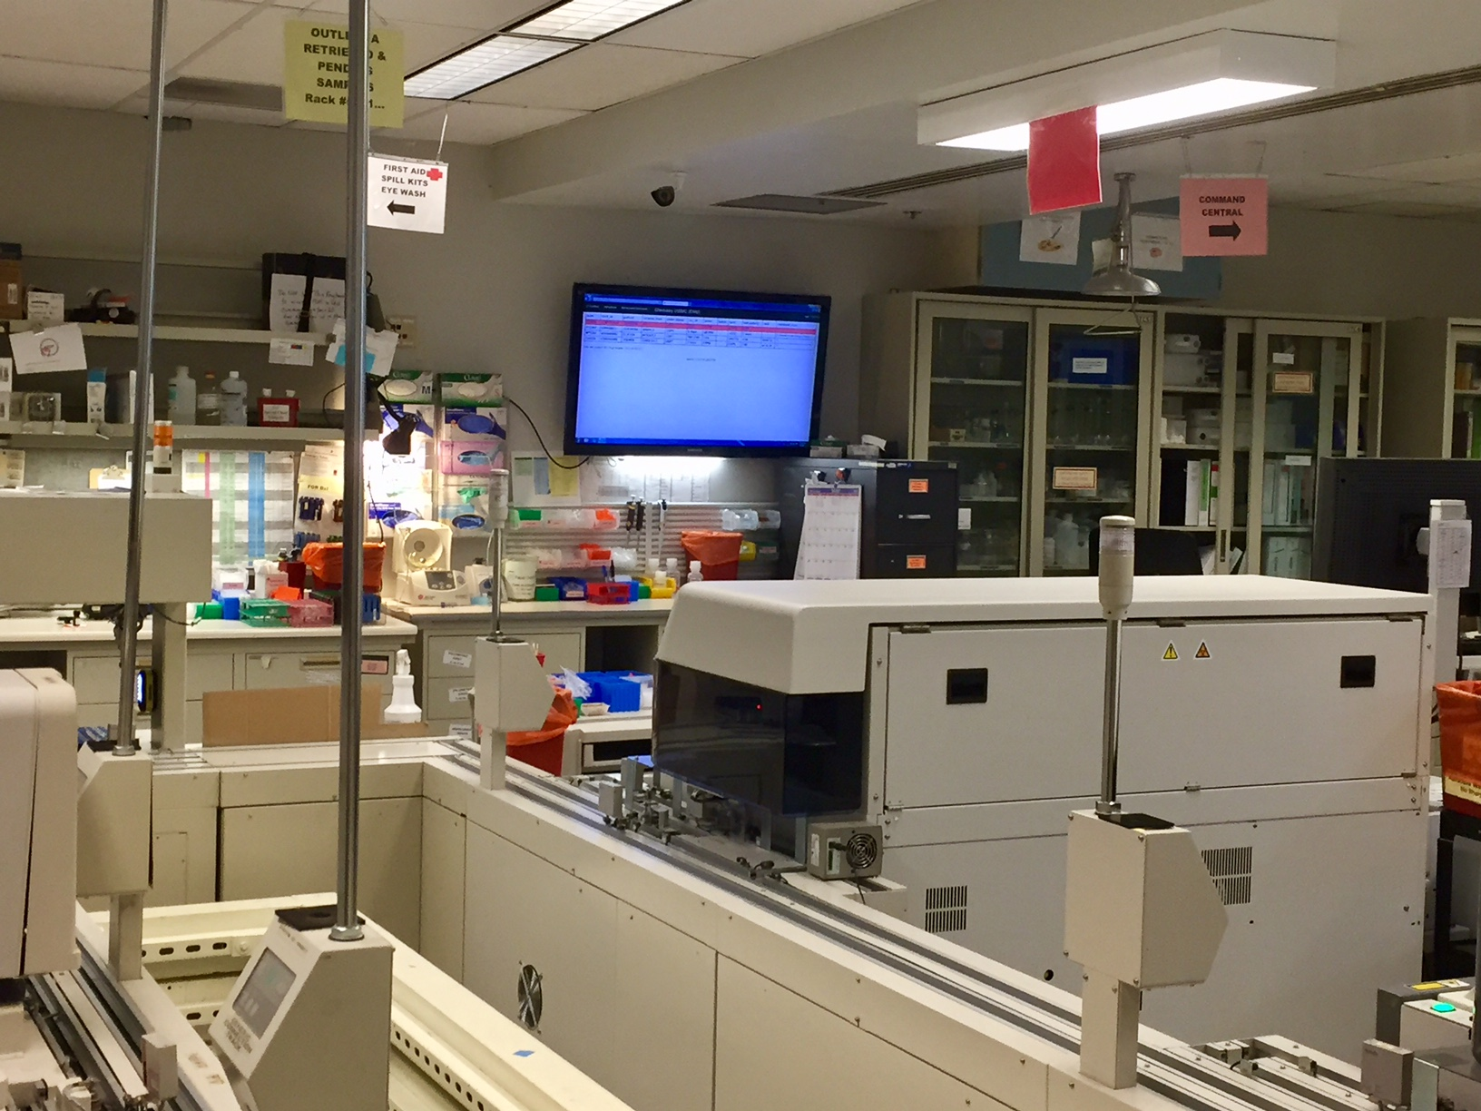
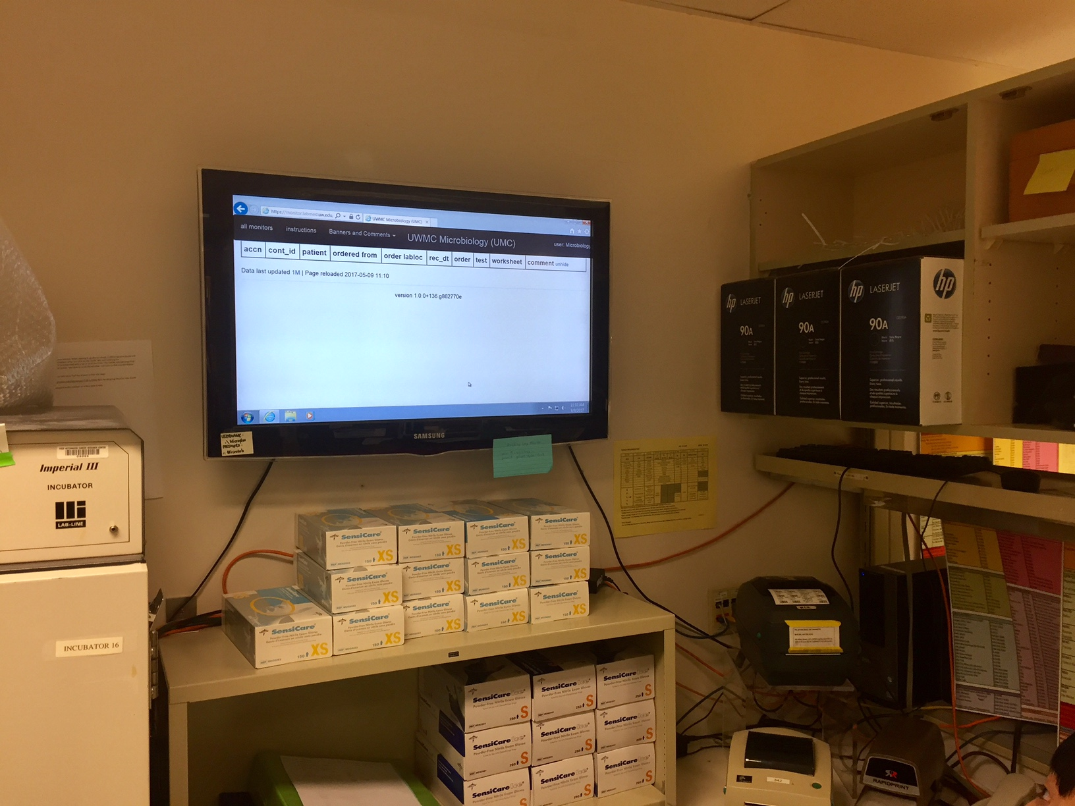
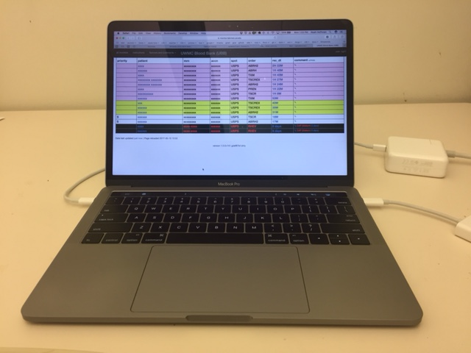
Hematology Line
Transfusion Services
Processing
Chemistry Line
Microbiology
My Laptop
> 30 worksheet groups in production since April, 2016
13 permanent displays across three hospitals

Slide 9
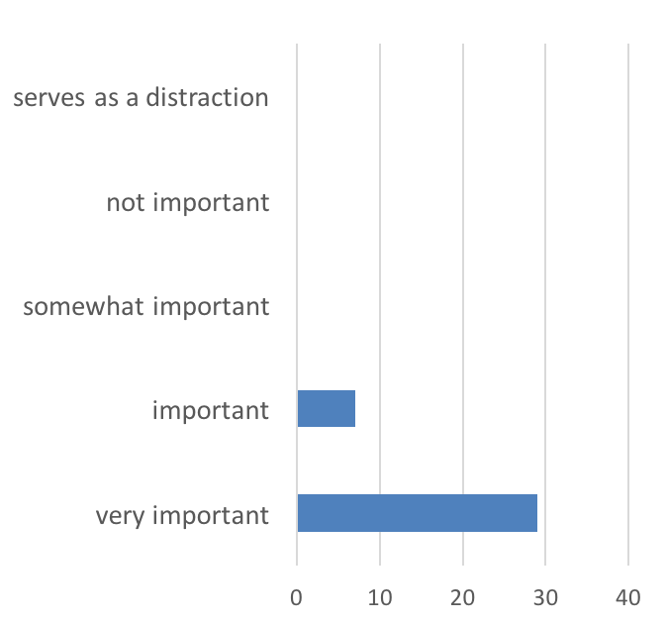
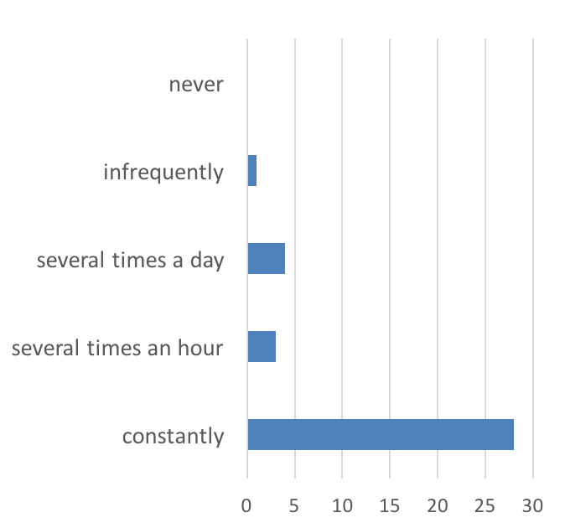
How would you characterize the importance of the PLM in the daily operation of your lab area?
How often is the PLM consulted in your lab area?

Slide 10
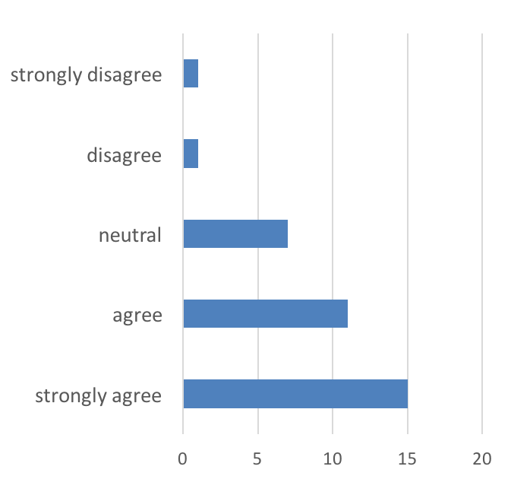
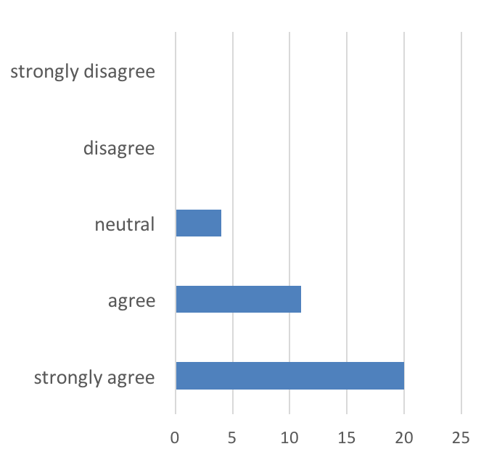
The PLM mostly replaces functionality in the LIS for monitoring pending tests (such as printed pending lists).
PLM Comments provide an important mechanism of communication in my lab area.

Slide 11
Use cases
Area | Use cases
Microbiology | Notification of stat gram stain orders
Transfusion services | Identify delayed testing, workload management
Automated Chemistry Line | Complex logic to display only delayed or time-sensitive orders; still use printed pending log at the end of the day
Hematology/coagulation | “We use it to anticipate coming work from the outside areas and to see when a sample is still pending”
Specimen Processing | Replaces printed pending list for write-ins
Mass Spectroscopy | Estimate workload; prompts to collect specimens before beginning a batch

Slide 12
Implementation details
Intersystems Caché (LIS data extracts from worksheets)
Application code in Python 2.7
Around 5000 LOC (rules comprise about half of total)
Flask web framework
SQLite database (comments)
Apache (web server)
Bootstrap (CSS)
Ansible (deployment, config. management)
Ubuntu 14.04 (virtualized)

Slide 13
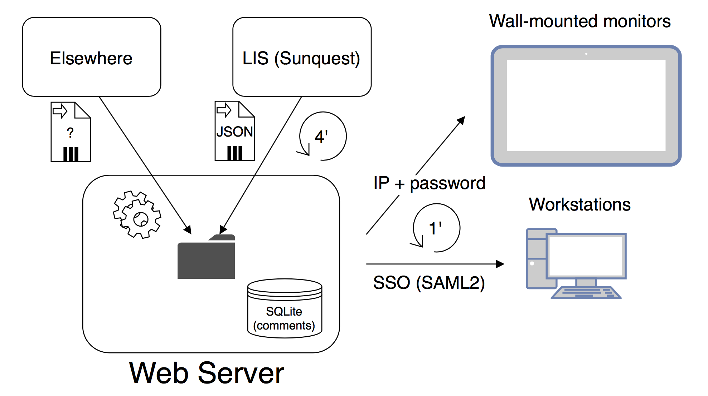
Architecture

Slide 14
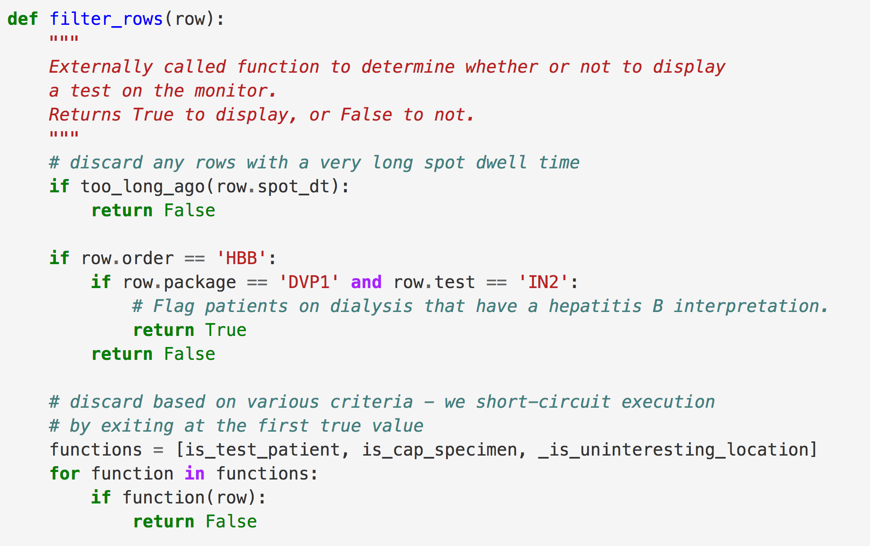
Rules engine
Rules implemented as Python functions
😀 Flexible, components can be unit tested
😐 Implemented by developer (no user interface)

Slide 15
Summary
Simple web application developed with relatively little effort and very low direct costs
Depends on access to data from the LIS; the rest is easy
Provides flexible platform for creating real-time displays of events from the LIS and other systems
Plays important role in lab operations
People like it

Slide 16
Thank you
Thomas Ekberg
University of Washington Department of Laboratory Medicine

Slide 17
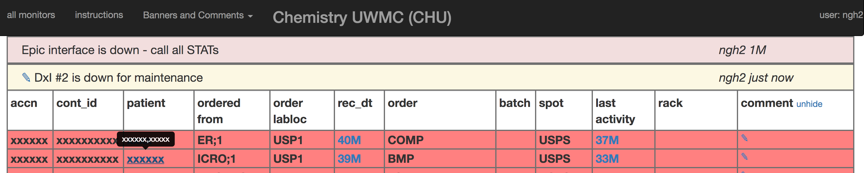
Banners

Slide 18
Project pre-requisites
Caché programming expertise (could substitute an API)
Infrastructure to self-host web application (could substitute cloud infrastructure)
Application development expertise (no substitute!)

Slide 19
Technical implementation goals
Meet data security requirements
Use free, open source components
Use existing departmental infrastructure
Flexible rules engine
System resilience
24/7 support
Fewest possible points of failure
Easy system recovery

